Slide 1

COVID-19
Exploring the impacts in Australia
By GROUP 2 – ISHAAN NIGAM, Namita sahoo and Sam Portelli

Slide 2
Exploring the impacts of COVID-19 in Australia
To what extent has the Coronavirus (COVID-19) pandemic impacted these areas in the last couple of years in Australia:
The Economy,
Unemployment rate,
Health.

Slide 3
Hypotheses of the project includes:
We expected to see an overall change and possible impacts in the following due to the pandemic.
Health:
Increased reported cases of suicides,
Increased use of crisis hotlines and
Increase in deaths
Unemployment:
Covid-19 and lockdowns had a marginal impact on Australian unemployment rate.
Business/ Economy:
Declined GDP and supply chain measures
Negative impact to Australian dollar trade-weighted Index
Decrease in Industry Gross Operating Profits

Slide 4
Scope of the project
Extracting COVID-19 Infections/ cases, Business, Unemployment, Health and International trade related data available for Australia – Primary data resources are:
Australian Bureau of Statistics (ABS)
Reserve Bank of Australia (RBA)
World Health organisation (WHO)
Australian Institute of Health and Welfare
NSW Ministry of Health and Coroner’s Court of Victoria
Analysing data for impacts of COVID-19 in key areas identified.
Visualising our analysis and summarizing the findings:
Plotting charts/ graphs (Bar, Pie, Line, Scatter, Boxplot, Line Regression, Correlation tests) using Matplotlib libraries

Slide 5
Preparing and Cleaning the data
Raw data retrieved from sources mentioned earlier were clean and well categorized. Minimal cosmetic adjustments were made before detailed analysis including:
Merging Covid-19 monthly infection cases with key measures for correlation analysis
Trimming and formatting the data frames to remove report headers and comments
Formatting the data frames into usable time series (Yearly, Quarterly, Monthly, Weekly)
Created columns to provide year and timepoint information

Slide 6




Impacts of COVID-19 on Australian - Business and Economy
Questions:
What was the immediate impact on Australian economy in terms of GDP and supply chain measures as the COVID-19 infections rose?
What was the impact on Australian Dollar exchange rates during June’20?
Was there an overall impact to the Gross Operating Profits?
Hypothesis:
Covid-19 - Restrictions and lockdowns had a marginal impact on Australian business and economy.

Slide 7
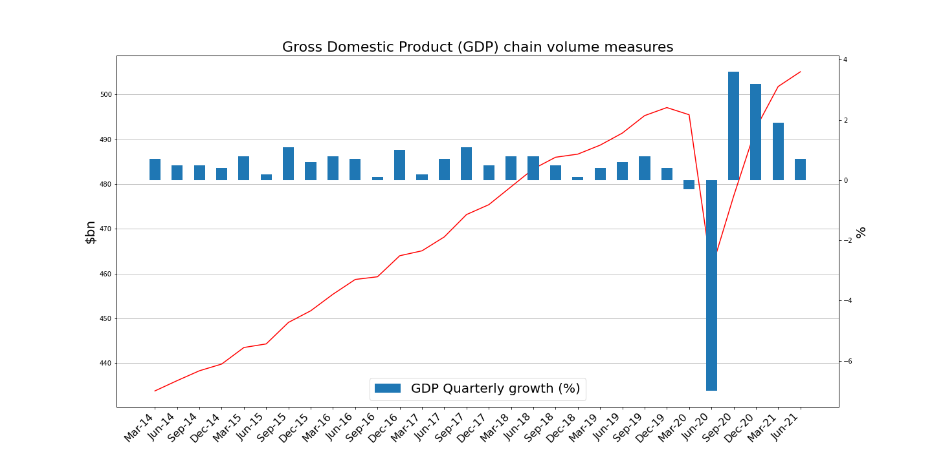
Impacts of COVID-19 on Australian - Business and Economy
Australian economy fell an unprecedented 7.0% in June'20 quarter as the COVID-19 pandemic movement restrictions started that quarter.
This records the first annual estimate of GDP for 2019/20, which fell 0.2%, ending Australia's longest streak of continuous growth for 28 years.
Australian economy rose 0.7% in June'21 quarter reflecting the easing of COVID-19 restrictions and the recovery in the labour market.
The Australian economy grew by 1.4% over 2020-21.
7% Decrease

Slide 8
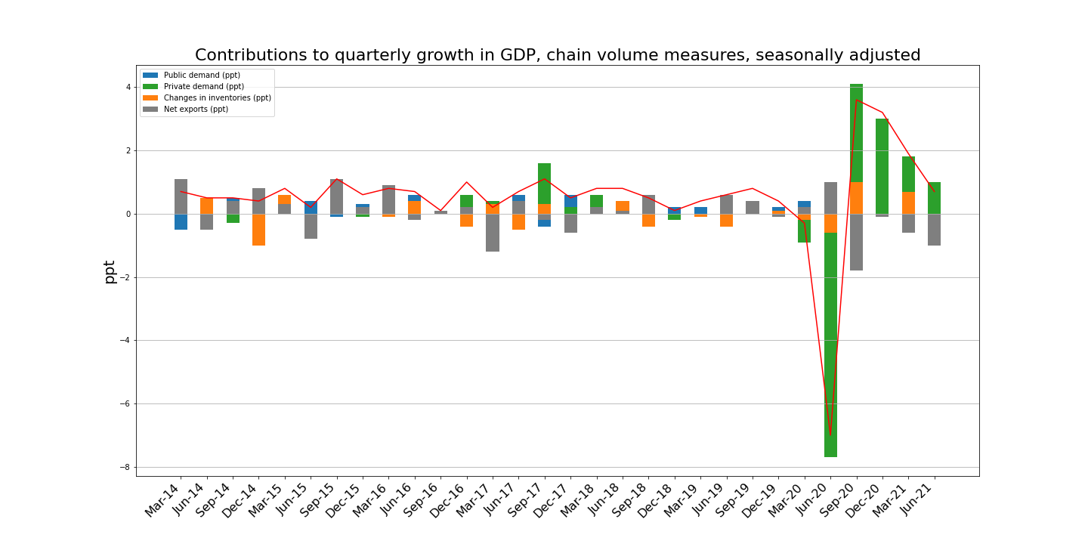
Impacts of COVID-19 on Australian - Business and Economy
Steep decline in the private demand driving the decline of overall GDP to 7% during June'20 quarter
Private demand drove the fall detracting 7.9 ppts from GDP, public demand partly offsets the fall, contributing 0.6 ppt, as government increased spending in response to COVID-19.
Domestic demand drives growth during June'21 quarter
The domestic economy drove growth, contributing 1.6 percentage points to the rise in GDP last quarter in June'21. Both private and public demand increased.
7.9 ppts Decreased - Private demand

Slide 9
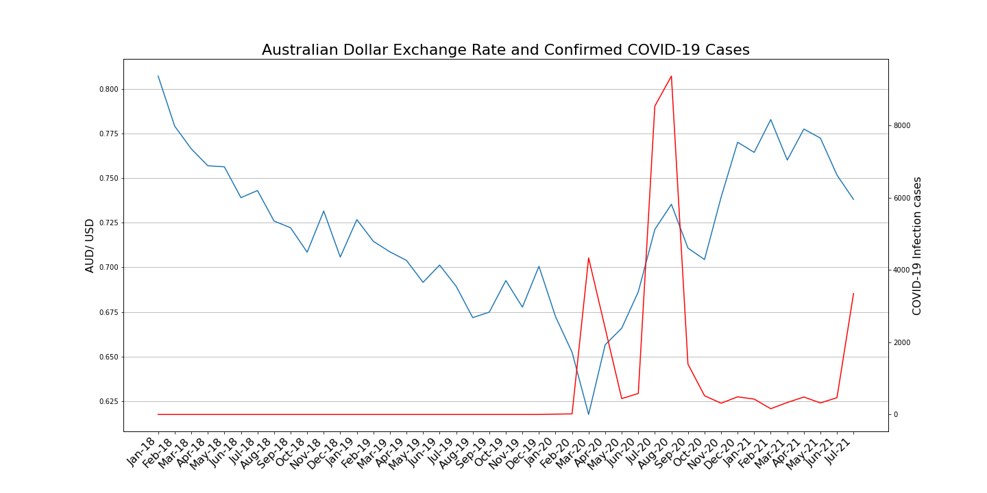
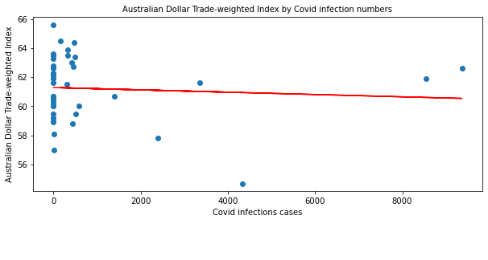
Impacts of COVID-19 on Australian - Business and Economy
Australian Dollar depreciated against the United States Dollar to levels not seen before the Global Financial Crisis (GFC) as the confirmed COVID-19 cases started increasing across Australia.
0.62 AUD/ USD
The correlation between covid infections cases and AUD Trade-weighted Index is -0.07 hence shows an overall very slight negative correlation.

Slide 10
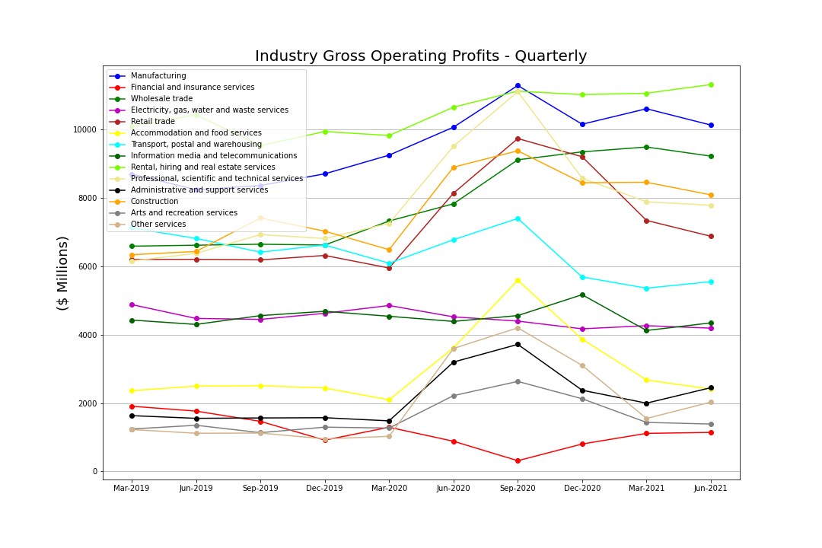
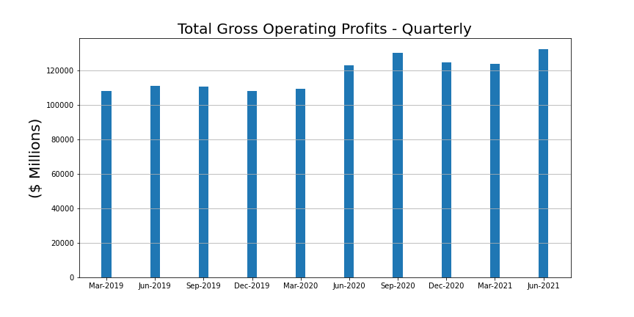
Impacts of COVID-19 on Australian - Business and Economy
Financial and insurance services: 35.5% ↓
Electricity, gas, water and waste services: 9.6% ↓
Information media/ telecommunications: 5.4% ↓

Slide 11
Covid-19 impact on the National Unemployment Rate
Hypothesis: Covid-19 and lockdowns had a marginal impact on Australian unemployment rate.

Slide 12
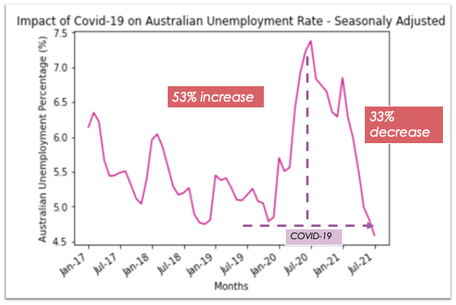
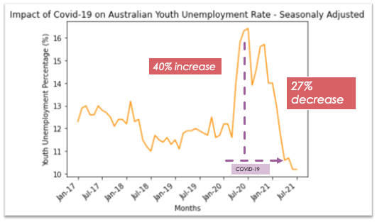
Impacts of COVID-19 on Australian Unemployment
Hypothesis: Hypothesis: Covid-19 increased unemployment rate in Australia.

Slide 13
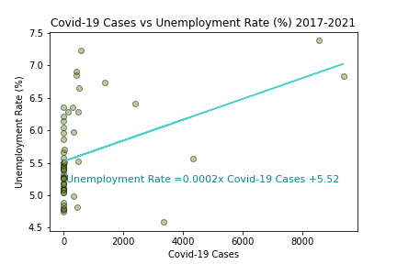
Impacts of COVID-19 on Australian Unemployment
Moderate positive correlation between Covid—19 Cases and Unemployment rate (Correlation coefficient of 0.42)
Summary:
53% increase in Unemployment rate in the month of highest reported Covid-19 cases (July 2020)
40% increase in Youth unemployment rate in the month of the highest reported Covid-19 cases (July 2020)

Slide 14
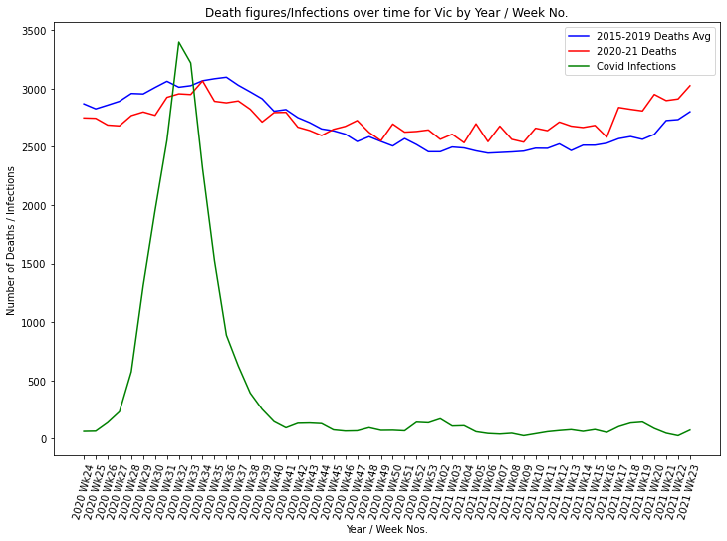
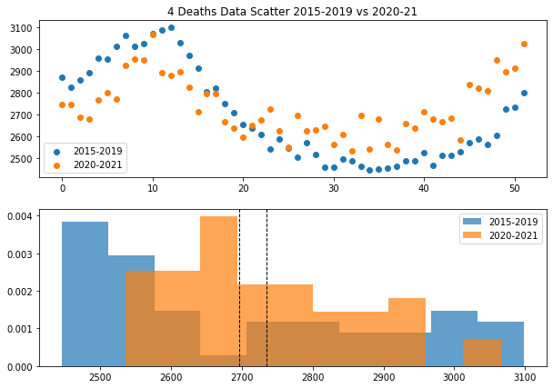
Impacts of COVID-19 on Australian - Health and People
There were a number of interesting observations when comparing deaths by week in 2020-21 with a baseline of 2015-2019 averages. Higher deaths during the peak of infections in March/April 2020 and increasing death rates in 2021.

Slide 15
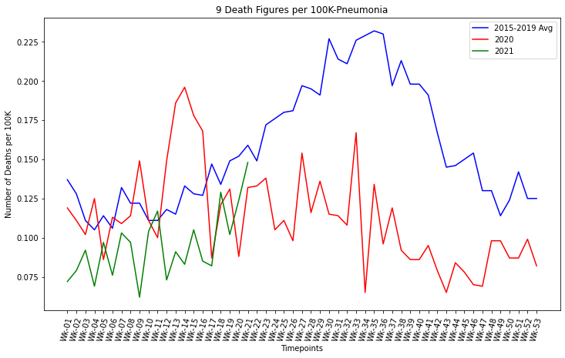
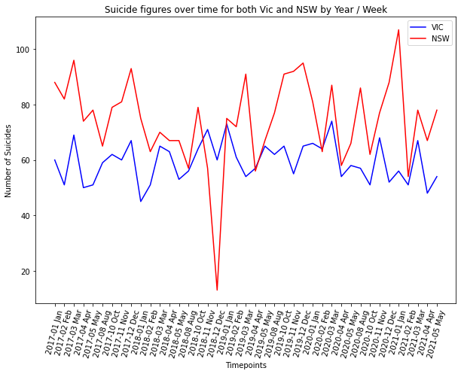
Impacts of COVID-19 on Australian - Health and People
Higher number of respiratory related deaths i.e. Pneumonia, Dementia/Alzheimers, Diabetes than the 2015-2019 average.
Suicide numbers were at a higher level in NSW than in Victoria, but consistent with that of previous years. More time is needed to investigate this further.

Slide 16
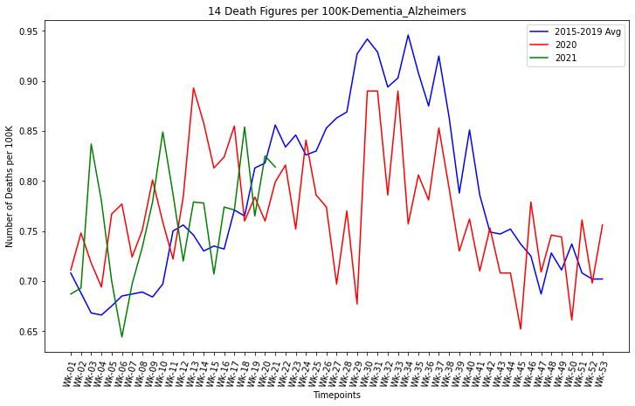
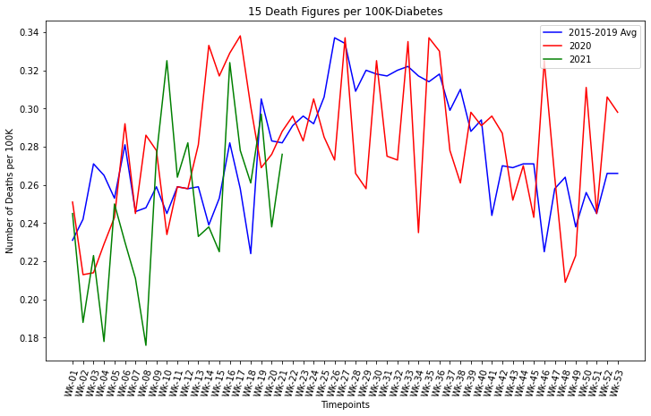
Impacts of COVID-19 on Australian - Health and People
This slide demonstrates the extra deaths in these areas: Dementia-Alzheimers & Diabetes Impacts

Slide 17
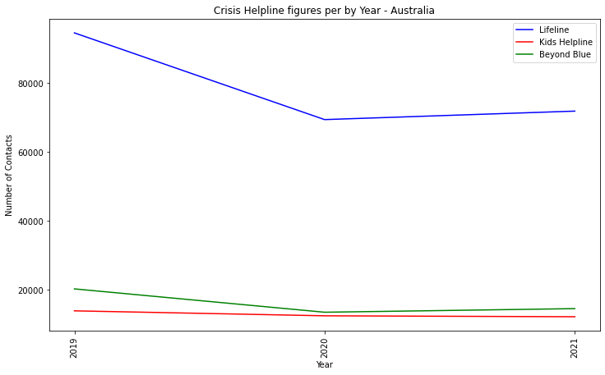
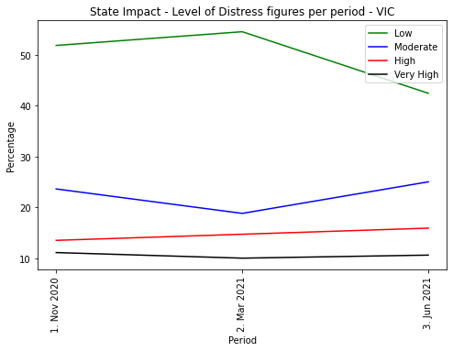
Impacts of COVID-19 on Australian - Health and People
Calls to Crisis helplines such as Lifeline, Kids Helpline and Beyond Blue actually dropped in 2020 and 2021 in comparison to 2019. Perhaps less interaction with people in general, due to isolation, contributed to this decline.
Psychological stress levels as measured by the K10 surveys, dropped in early 2021 and increased in the later months in the moderate category.

Slide 18
Conclusion
Health:
More deaths due to an overload of the health system - more deaths from other causes were the result i.e. pneumonia.
Less deaths from the common flu = only 36 in 2020 and 0 in 2021 (amazing) vs 902 in 2019 - due to lockdown and use of masks?
Less mental health issues/stress levels resulting from isolation and working from home –positive benefits
Unemployment:
Currently seeing a spike in Covid-19 cases again (Vic, NSW). Will need to complete correlation test again later this year to study the impact of Covid-19 from July-December 2021.
Further analysis needs to be conducted to see if political and economic policies introduced in the last two years correlated with the rise/fall of the unemployment rate.
Business/ Economy:
Covid-19 had a significant impact in the initial quarter (June’20) on Australian business and economy.
Impact of further restrictions and rise in covid-19 cases during September’21 quarter on business indicators

